Slide 1

MIRCHI BREED CLASSIFICATION
...AIML COURSE PROJECT...

Slide 2
TEAM MEMBERS:
AKHIL RAMPELLI 2103A51066
HARSHA VARDHAN T 2103A51015
REBBA BHUVAN SAI 2103A51288
Under the guidance of
Mr. NARESH KUMAR SRIPADA
Assistant Professor, Department of CSE

Slide 3
TABLE OF CONTENTS
01
04
02
05
03
06
Introduction
Methodology
Literature survey
Results & Discussions
Data preprocessing
Conclusion

Slide 4
TABLE OF CONTENTS
07
08
Future Scope
References

Slide 5
1. INTRODUCTION 1.1 PROBLEM STATEMENT
To develop an artificial intelligence and machine learning based classification model that can accurately classify the type of breed of mirchi that farmer has grown in his field using Logistic Regression.

Slide 6
1.2 EXISTING SYSTEM
There are several existing systems and platforms that provide data and analysis on the details and various precautions of how to yield a good amount of mirchi but there is no such existing system in the market on the classification of mirchi breed in the market.When it comes to the situation of selling the crop in the market it is necessary to classify the breed of the crop. Similarly,Chilli is used as a principle ingredient of various curries and chutneys, also used in vegetables, spices, condiments, sauces and pickles. Pungency in chillies is due to the active constituent, an alkaloid.
However, these existing systems have limitations, including a lack of comprehensive data analysis and classification models that accurately measures the type of conditions that are needed for high yield of mirchi crop needed but there are unable to classify the type of breed.

Slide 7
1.3 PROPOSED SOLUTION
The proposed system will focus on analyzing and classifying the breed of the mirchi using CNN model. The system will use a Convolution Neural Network model to develop classification models for different breeds , and their characteristics We have collected a wide range of data of different breeds.We have trained the model and the values of Hues,intensity and saturation is used to predict the breed of the crop.
To better understand the data, the system will use various types of graphs, including line plots, box plots and bar plots. These plots will help visualize the data and identify any trends, patterns, or outliers.

Slide 8
1.4 DEFINE OBJECTIVES
The main objectives of this project are to:
1. Develop a classification model to identify the breed of a test data.
2. Analyze the factors that contribute to classifying the different breeds of chilli crop.
3. Identify hues intensity and saturation values of different fruits of chilli crops.
4. Provide valuable insights into the impact of Cost across different regions to guide farmers and mitigate the effects of the breed variety.

Slide 9
2. LITERATURE SURVEY
In this section, we will document the literature survey we conducted related to the problem statement of classifying and analyzing of Mirchi breeds of different varieties using artificial intelligence and machine learning techniques.
We have went to the fields of farmers to investigate the characteristics of different varieties of mirchi breeds and we have taken clear snapshot of different types chilli for our training dataset and we have noted each and every information given by the farmer to identify the different types of mirchi breeds.
The data which we have collected from the fields in the form of snapshots is used to retrieve the different characteristics of the breeds.We have imported the libraries in python such as image pillow these libraries helped us to retrieve the pixel values of the snapshots we have collected.
We planned to compare these pixel values with the test data and then the characterises of the test data match with the characteristics of the trained data ,then we have classified the test data as that particular breed.

Slide 10
3. DATA PREPROCESSING 3.1 DESCRIBING DATASET
The chilli breed .csv dataset is a collection of images of three data on COVID-19 cases and deaths from countries around the world. It is maintained by the website Our World in Data (OWID), which is a non-profit organization that provides research and data to make progress against global challenges.
The dataset contains over 300 images, including their names started at a place on the chilli folder.

Slide 11
3.2 DATA CLEANING
Checking for Null Values and Removing Null Values

Slide 12
3.3 DATA VISUALISATION DHAMINI BREED

Slide 14
3.3 DATA VISUALISATION JYOTHIKA BREED

Slide 15
3.3 DATA VISUALISATION TEJA BREED

Slide 17
CHANNELS

Slide 18


Slide 19
4. METHODOLOGY 4.1 PROCEDURE TO SOLVE THE PROBLEM
Data collection: The first step is to collect the dataset in such a way that suits the problem statement in a best way.We have collected the required data by going to the fields of farmers and we captured the snapshots of the images of yield.We have also noted the corresponding breed name by enquiring the farmers of the respective field.
Data cleaning and pre-processing: The collected data needs to be cleaned and pre-processed to remove any inconsistencies or missing values. This involves data cleaning techniques such as handling missing data, data imputation, and outlier detection.

Slide 20
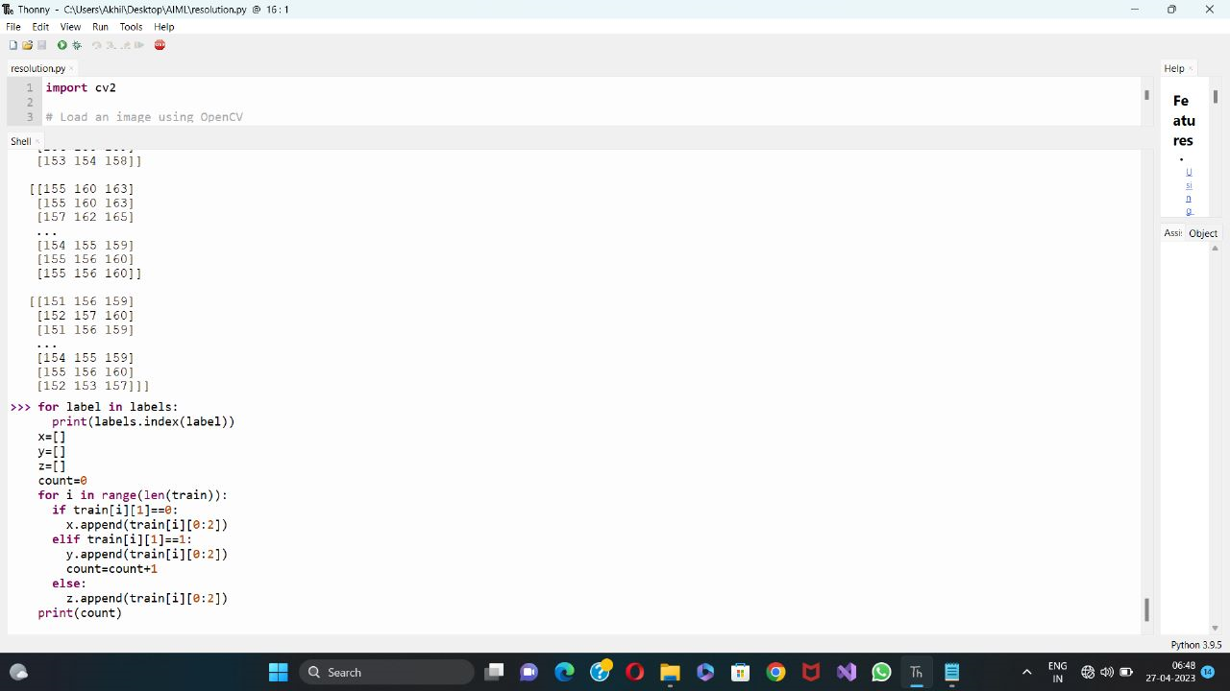

Slide 21
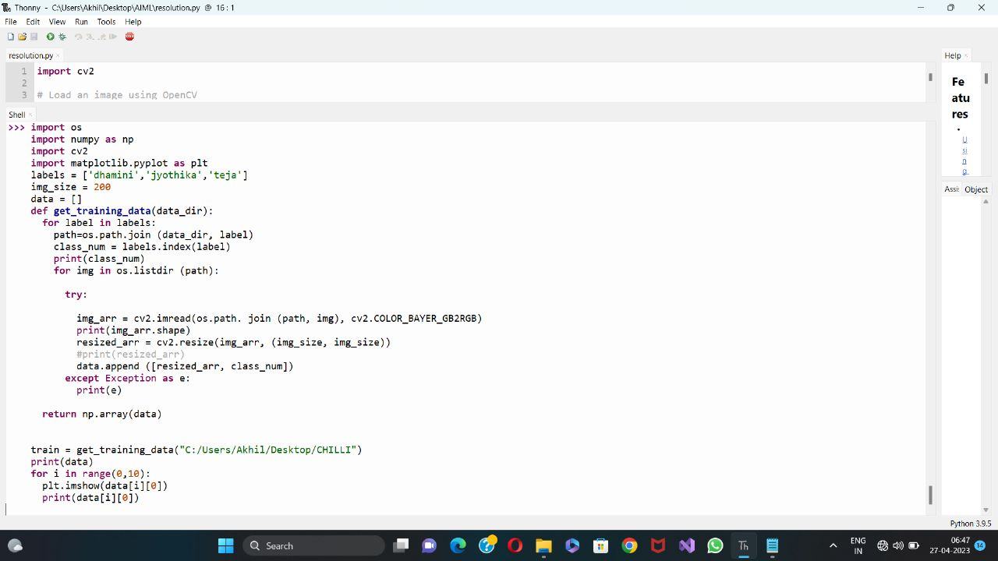

Slide 22
for label in labels:
print(labels.index(label))
x=[]
y=[]
z=[]
count=0
for i in range(len(train)):
if train[i][1]==0:
x.append(train[i][0:2])
elif train[i][1]==1:
y.append(train[i][0:2])
count=count+1
else:
z.append(train[i][0:2])
print(count)
x
y
z
x=[]
y=[]
for i,j in data:
x.append(i)
y.append(j)
x
y
from sklearn.model_selection import train_test_split
import numpy as np
import matplotlib.pyplot as plt
xtrain, xtest, ytrain, ytest = train_test_split(x, y, test_size = 0.25, random_state = 47)
xtrain
import numpy as np
x=np.array(x).reshape(1000,120000)
x
print(np.array(xtrain).shape)
print(np.array(ytest).shape)
x1=np.array(x).shape
x1
y1=np.array(y).shape
y1

Slide 23
d=np.array(xtrain).reshape(750,120000)
d
e=np.array(xtest).reshape(250,120000)
e
print(np.asarray(d.shape))
from sklearn.preprocessing import StandardScaler
sc_x = StandardScaler()
d= sc_x.fit_transform(d)#normalizing
e = sc_x.transform(e)
from sklearn.linear_model import LogisticRegression
model = LogisticRegression(random_state = 0)
from sklearn.linear_model import LogisticRegression
# Create and fit a logistic regression model with increased max_iter
model = LogisticRegression(random_state=0, max_iter=1000)
y_pred=model.predict(e)
y_pred
from sklearn.metrics import confusion_matrix
cm=confusion_matrix(ytest,y_pred)
print("Confusion matrix:\n",cm)
Confusion matrix:
[[42 1 5]
[ 0 27 0]
[ 5 0 5]]
from sklearn.metrics import accuracy_score
print("Accuracy:",accuracy_score(ytest,y_pred))
Accuracy: 0.8705882352941177

Slide 24
4.2 MODEL TRAINING AND TESTING
print("predicted value for training value",knn.score(d,ytrain))
print("predicted value for testing value",knn.score(e,ytest))
print("Overall Accuracy:",knn.score(sc_x.transform(x),y))
predicted value for training value 0.7777777777777778
predicted value for testing value 0.6941176470588235
Overall Accuracy: 0.7566765578635015
y_pred=knn.predict(e)
y_pred
from sklearn.metrics import confusion_matrix
cm=confusion_matrix(ytest,y_pred)
print("Confusion matrix:\n",cm)
Confusion matrix:
[[42 1 5]
[ 0 27 0]
[ 5 0 5]]

Slide 25
MODEL EVALUATION AND ANALYSIS
from sklearn.metrics import accuracy_score
print("Accuracy:",accuracy_score(ytest,y_pred))
Accuracy: 0.8705882352941177
from sklearn.neighbors import KNeighborsClassifier
knn=KNeighborsClassifier(n_neighbors=12)
y_pred = model.predict(e)
y_pred
print("predicted value for training value",knn.score(d,ytrain))
print("predicted value for testing value",knn.score(e,ytest))
print("Overall Accuracy:",knn.score(sc_x.transform(x),y))
predicted value for training value 0.7777777777777778
predicted value for testing value 0.6941176470588235
Overall Accuracy: 0.7566765578635015
y_pred=knn.predict(e)
y_pred
from sklearn.metrics import confusion_matrix
knns=confusion_matrix(ytest,y_pred)
print("Confusion matrix:\n",knns)
Confusion matrix:
[[31 12 5]
[ 3 24 0]
[ 4 2 4]]

Slide 26
from sklearn.naive_bayes import GaussianNB
nb = GaussianNB()
nb.fit(d,ytrain)
import numpy as np
print("Training Accuracy",nb.score(d,ytrain))
print("Testing Accuracy",nb.score(e,ytest))
print("Overall Accuracy:",nb.score(sc_x.transform(x),y))
Training Accuracy 0.8452380952380952
Testing Accuracy 0.788235294117647
Overall Accuracy: 0.8308605341246291
y_pred=nb.predict(e)
y_pred
from sklearn.metrics import confusion_matrix
nbb=confusion_matrix(ytest,y_pred)
print("Confusion matrix:\n",nbb)
Confusion matrix:
[[41 3 4]
[ 6 21 0]
[ 3 2 5]]
from sklearn import svm
SVM= svm.SVC()
SVM.fit(d, ytrain)
print("Training Accuracy",SVM.score(d,ytrain))
print("Testing Accuracy",SVM.score(e,ytest))
print("Overall Accuracy:",SVM.score(sc_x.transform(x),y))
Training Accuracy 0.9722222222222222
Testing Accuracy 0.8823529411764706
Overall Accuracy: 0.9495548961424333
y_pred=SVM.predict(e)
y_pred
from sklearn.metrics import confusion_matrix
SVMS=confusion_matrix(ytest,y_pred)
print("Confusion matrix:\n",SVMS)
Confusion matrix:
[[45 3 0]
[ 3 24 0]
[ 4 0 6]]

Slide 27
4.3 PREDICTION AND FORECASTING
from sklearn.metrics import accuracy_score
accuracy_model = accuracy_score(y,model.predict(sc_x.transform(x)))
print("Logistic regression:",accuracy_model)
accuracy_nb = accuracy_score(y,nb.predict(sc_x.transform(x)))
print("navie bayes;",accuracy_nb)
accuracy_knn = accuracy_score(y,knn.predict(sc_x.transform(x)))
print("KNN:",accuracy_knn)
accuracy_SVM = accuracy_score(y,SVM.predict(sc_x.transform(x)))
print("Support vector machine:",accuracy_SVM)
Logistic regression: 0.9673590504451038
navie bayes; 0.8308605341246291
KNN: 0.7566765578635015
Support vector machine: 0.9495548961424333

Slide 28
import matplotlib.pyplot as plt
fig = plt.figure()
ax = fig.add_axes([0,0,1,1])
algo = ['logistic reg','Naive bayes','knn clf','SVM']
accuracy = [accuracy_model*100,accuracy_nb*100,accuracy_knn*100,accuracy_SVM*100]
ax.bar(algo[0],accuracy[0],color = 'b')
ax.bar(algo[1],accuracy[1],color = 'y')
ax.bar(algo[2],accuracy[2],color = 'pink')
ax.bar(algo[3],accuracy[3],color = 'green')
plt.xlabel('Classifiers------------>')
plt.ylabel('Accuracies------------->')
plt.title('ACCURACIES RESULTED')
plt.show()

Slide 29
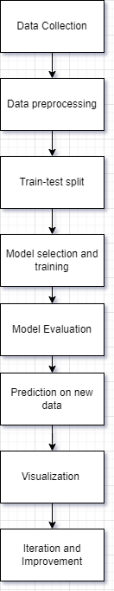
4.4 MODEL ARCHITECTURE

Slide 30
4.5 SOFTWARE DESCRIPTION
This project is developed using Thonny software, which is a popular web- based interactive development environment for creating and sharing data science projects. The code is written in Python programming language and uses several Python libraries, including Pandas, NumPy, Scikit-learn, Matplotlib, and Seaborn.
Pandas is a library that is used for data manipulation and analysis. It provides a set of data structures and functions to work with structured data.
NumPy is a library that is used for numerical computing with Python. It provides a powerful array processing capability and mathematical functions to work with large, multi-dimensional arrays and matrices. In this project, NumPy is used to perform numerical operations, such as calculating mean and standard deviation of the data.

Slide 31
3. Pillow is the friendly PIL fork by Jeffrey A. Clark (Alex) and contributors. PIL is the Python Imaging Library by Fredrik Lundh and Contributors. The Pillow library contains all the basic image processing functionality. You can do image resizing, rotation and transformation. Pillow module allows you to pull some statistics data out of image using histogram method, which later can be used for statistical analysis and automatic contrast enhancement.PIL stands for Python Imaging Library, and it's the original library that enabled Python to deal with images. PIL was discontinued in 2011 and only supports Python 2. To use its developers' own description, Pillow is the friendly PIL fork that kept the library alive and includes support for Python 3.
4. Matplotlib is a library that is used for creating visualizations and plots. It provides a set of functions to create various types of plots, such as line, bar, scatter, and histogram. In this project, Matplotlib is used to create scatter plots and regression lines to visualize the relationship between the input variables and the number of new COVID-19 cases.

Slide 32
5. RESULTS & DISCUSSIONS
The main objective of this project was to classify the breed of a particular type of chilli crop .The primary intention of this project is to help the farmers information about identifying the different types of parameters.The farmer can also have an overview of the crop which he need to grow in the future year.We have successfully deployed the model using Convolution Neural network.
The dataset used in this project consists of nearly 300 images of training data ,which helps in extracting the characteristics of different breeds of the mirchi crop data .We have extracted the hues, intensity,saturation etc from this dataset and collectively these metrics are used to deploy the model.

Slide 33
The model was also used to predict the number of new if any new breeds developed in the future by training the model with the new data .We have tested the model with various test data ,the model gave an accurate result.The model worked with 97% accuracy with the tested data.
Overall, the results of this project show that Convolution Neural Network can be used to classify the type of breed using the characteristics based on various factors. However, it is important to note that the model's accuracy may vary depending on the quality and quantity of data used in the model. Additionally, other machine learning algorithms can be explored to improve the model's performance.

Slide 34
6. CONCLUSION
In conclusion, this project demonstrated the use of machine learning techniques to classify based on various factors such as colour, Hue, Intensity, saturation, and grey scale. The Convolution Neural Network model was used to build the classsification model, and various evaluation metrics were used to assess the accuracy of the model.
Based on the results, the model achieved a reasonable level of accuracy in classifying the new breeds of Chilli. However, the model can be further improved by incorporating additional features such as the number of days required to grow a particular field, weather conditions, and cost per quintal data.

Slide 35
7. FUTURE SCOPE
Moreover In future, this project can be extended by building more advanced machine learning models such as Random Forest, Gradient Boosting, or Neural Networks to further improve the accuracy of predictions.
Overall, this project provides a starting point for future research in Classifying Breeds of Mirchi crops and can be used as a suggestion for farmers effective yield farmers.

Slide 36
8. REFERENCES
Pillow documentation. (2021). Retrieved from https://pandas.pillow.org/
Pandas documentation. (2021). Retrieved from https://pandas.pydata.org/docs/ NumPy documentation. (2021). Retrieved from https://numpy.org/doc/stable/
Scikit-learn documentation. (2021). Retrieved from https://scikit- learn.org/stable/documentation.html
Matplotlib documentation. (2021). Retrieved from https://matplotlib.org/stable/contents.html
Seaborn documentation. (2021). Retrieved from https://seaborn.pydata.org/

Slide 37
THANK YOU

Slide 38
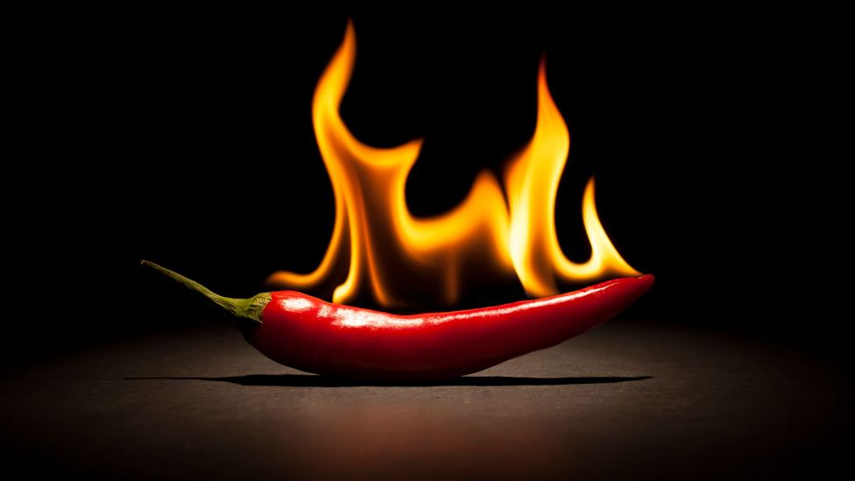
ANY QUESTIONS ?

